Slide 1

GAMETOGENESIS
OOGENESIS
Dr. Samer Alnussairi

Slide 2
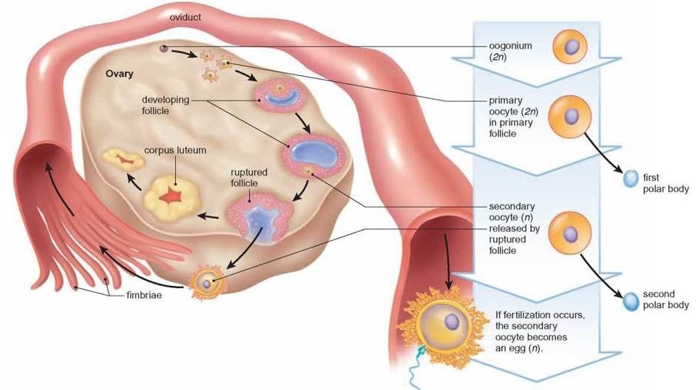
Objectives
Oogenesis
(prenatal & postnatal)
Ovulation

Slide 3
In preparation for fertilization,
Germ cells undergo
Gametogenesis (include meiosis).
Cytodifferentiation to complete their differentiation.

Slide 4
Gametogenesis
Is the process of formation of gametes from germ cells in the testes and ovaries.
Male & female germ cells have the same origin, primordial germ cells

Slide 5
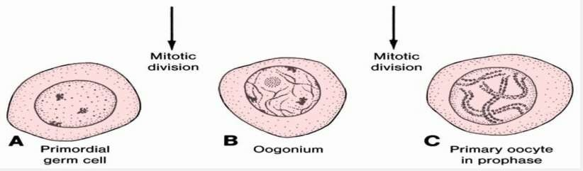
Oogenesis
Is the process where by oogonia differentiate into mature oocytes. Prenatal oogenesis occurs during embryonic development before birth. Postnatal oogenesis occurs after birth.

Slide 6
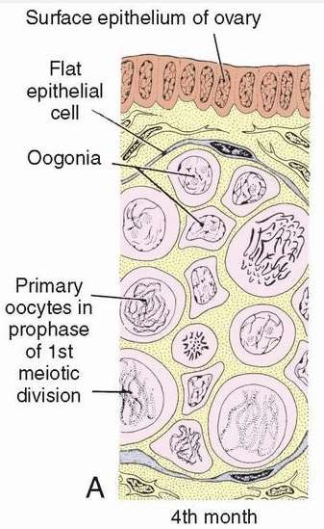
Oogonia
By the end of the 3rd month, the majority of the oogonia continue to divide by mitosis, but some of them give rise to primary oocytes that enter prophase of the first meiotic division.

Slide 7
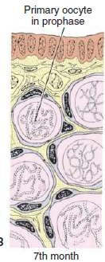
By the 5th month of prenatal development, germ cells in the ovary reaches its maximum( 7 million).
₇th
By the month,
the majority of oogonia have
degenerated,
All surviving primary oocytes have entered prophase of meiosis I, and most of them are individually surrounded by a layer of flat epithelial cells
(primordial follicle ).

Slide 8
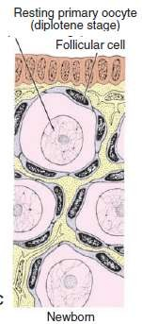
Maturation of the oocytes
- At birth and during childhood
Near the time of birth, all primary oocytes have started prophase of meiosis I, but instead of proceeding into metaphase, they enter the diplotene stage , a resting stage during prophase.
The total number of primary oocytes at birth is estimated to vary from 700,000 to two million remain.
During childhood, most oocytes become atretic.
only approximately 400,000 are present by the beginning of puberty, and fewer than 500 will be ovulated.

Slide 9
- At puberty
Each month, 15 to 20 follicles begin to mature and passing through three stages:
Primary (Preantal).
Secondary (Antral).
Tertiary or mature vesicular or Graafian follicle (Preovulatory).
Under normal conditions, only one of these follicles reaches full maturity and the others degenerate and become atretic.

Slide 10
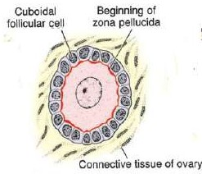
Unilaminar Primary Follicle
Primary oocyte (The total number of primary oocytes at birth is estimated to vary from 600,000 - 800,000).
Surrounded by a layer of cuboidal follicular epithelium cells.
Beginning of zona pellucida

Slide 11
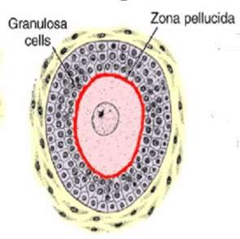
Multilaminar Primary Follicle
The follicular cells change from flat epithelial to cuboidal and proliferate to several layers called granulosa layer.
Zona pellucida.

Slide 12
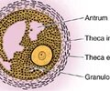
Secondary (Antral) Follicles
Fluid – filled spaces appear between the granulosa cells. coalescence of these spaces form the antrum which is crescent shaped, but with time it enlarges.
The follicle is surrounded by:
Theca Interna.
Theca Externa.

Slide 13
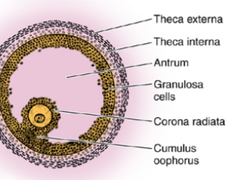
Tertiary Follicle
Granulosa cells surrounding the oocyte form the cumulus oophorus.

Slide 14
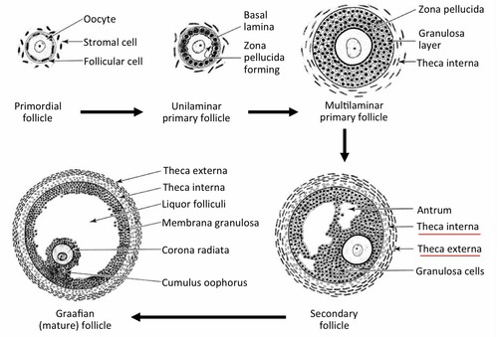
Maturation of the oocytes

Slide 15
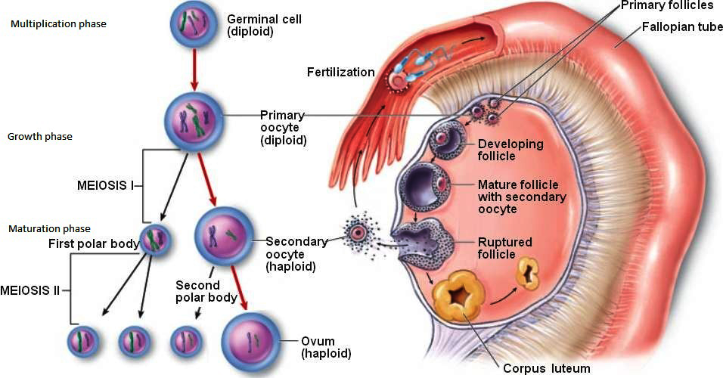
Maturation of the oocyte
Meiosis I is completed, resulting in formation of two
daughter cells of unequal size, each with 23 double-
structured chromosomes. One cell, the secondary
oocyte, receives most of the cytoplasm; the other, the first polar body, receives practically none.
The cell then enters meiosis II but arrests in metaphase approximately 3 hours before ovulation.

Slide 16
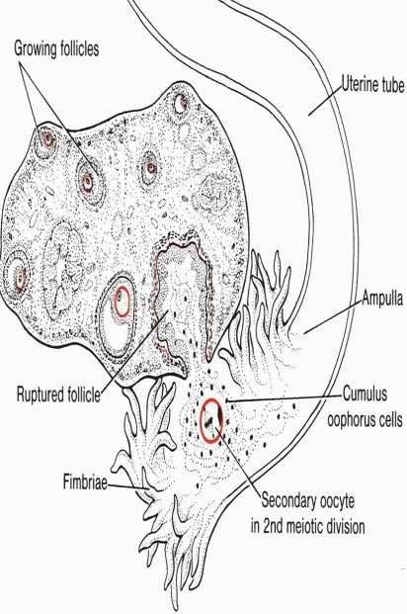
Ovulation
With onset of puberty and under the hormonal control the Ovarian Cycle will start.
The oocyte, in metaphase of
meiosis II, is discharged from ovary together with a large number of cumulus oophorus cells.
Some of the cumulus oophorus cells then rearrange themselves around the zona pellucida to form the corona radiata
Meiosis II is completed only if the oocyte is fertilized; otherwise, the cell degenerates approximately 24 hours after ovulation.
The first polar body may undergo a second division.

Slide 17


